Slide 1
Graph Neural Network Based Anomaly Detection
SINGAPURA RAVI VARUN

Slide 2
Agenda
Introduction to Graphs
Experiments/Approaches
Results
Flaws in SOTA (GDN, GRELEN)
Conclusion
Future Work

Slide 3
Introduction
Info class internal Department / Singapura Ravi Varun / Summer Job Presentation
29 August 2024

Slide 4
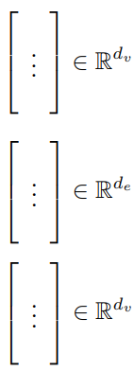
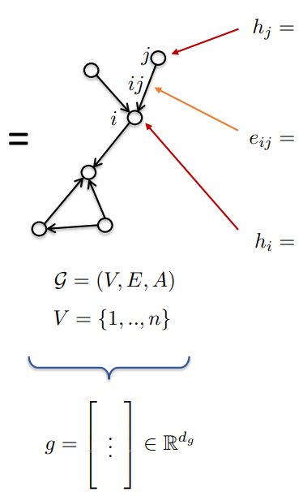
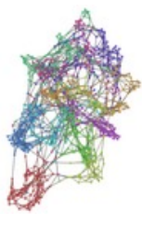

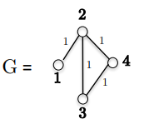
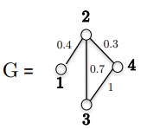


What are Graph-structured data?
A graph G over a network of sensors can be defined as G = (V,E,A), where,
V represents vertices/nodes.
E represents edges.
A represents adjacency matrix.
Then, the graph features are as follows:
Node features: $h_{i}, h_{j}$ (sensor types)
Edge features: $e_{i},e_{j}$ (relationship between sensors)
Graph features: $g$ (status of the sensor network)
Adjacency matrix represents structural information about the network:
Binary Matrix:
Weighted Matrix:

Slide 5
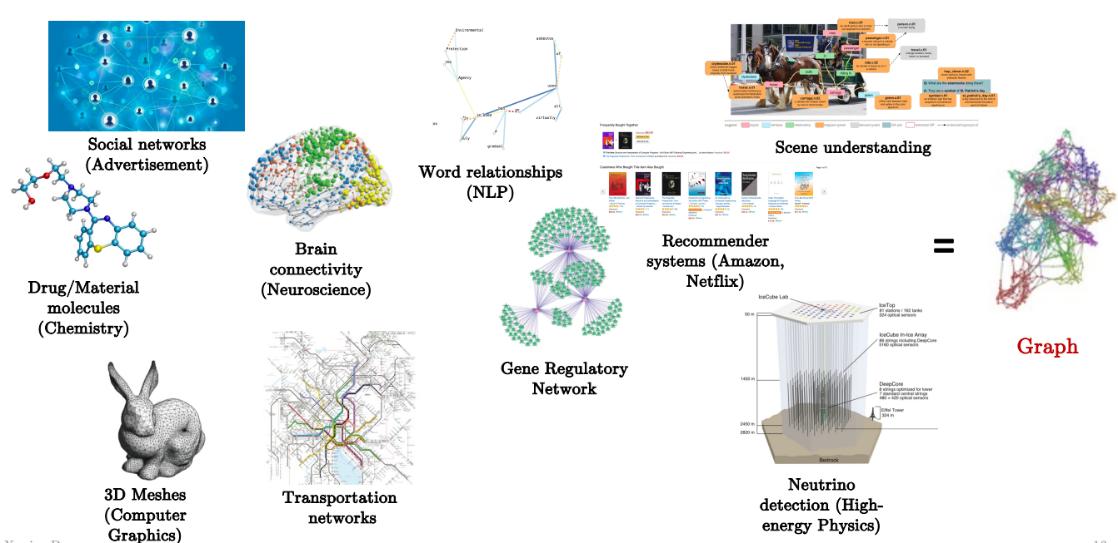
Examples of Graph Structured Data

Slide 6
Existing Use Cases
Chip design (Google)
Resource management
Scene reasoning (Meta)
Recommendation (UberEats/ Pinterest/ Alibaba)
Fake news detection
Finance
Natural Language Processing
Knowledge graphs (Amazon)
Transportation (Google Map ETA)
Autonomous driving (NVIDIA)
Protein & drug design (Google DeepMind/ Microsoft/ AstraZeneca)
Energy physics & simulations (Google DeepMind)
Code bug detection
Genomics

Slide 7
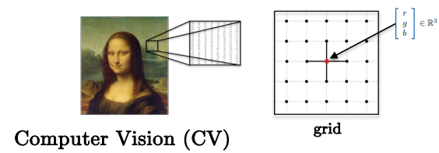
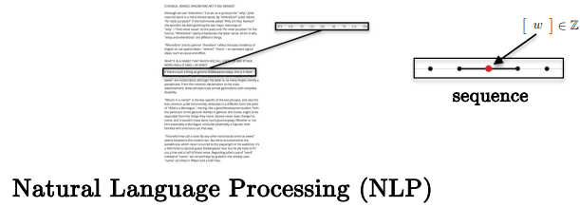
Why Graphs?
Standard Deep Learning technologies such as CNNs, RNNs and Transformers in CV and NLP are successful but limited largely to work with grid/sequence data.
However, as shown in the previous slide, graph structured data are not based on based on grid/sequence.
Graph Neural Networks are a solution to build universal and broadly applicable architectures.
Another advantage of using graphs in ML is the ability to model relationships in complex domains to achieve better interpretability and performance.

Slide 8
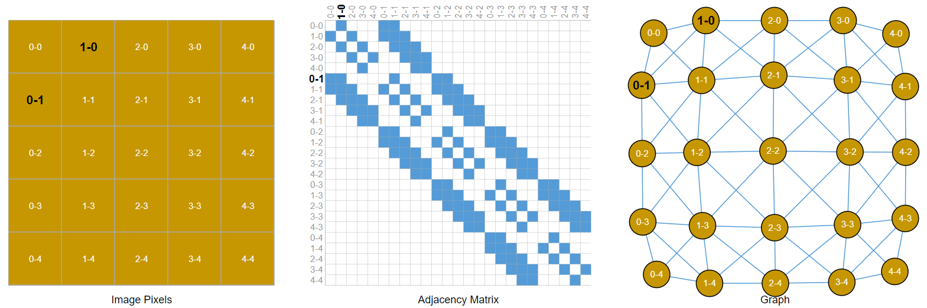
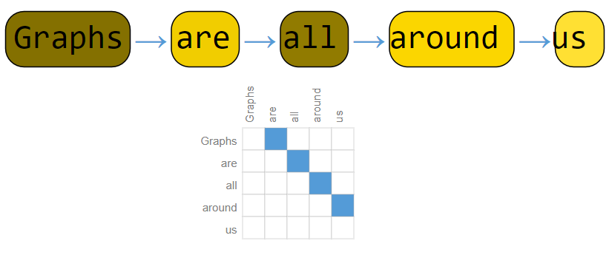
Images and Text as Graphs

Slide 9

Intuition
$$\sim$$

Slide 10


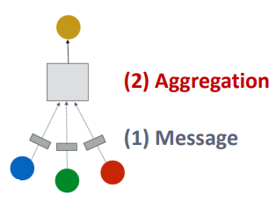
Theory
A simple message passing GNNs consists of two steps:
Message: each node computes a message; example could be a simple linear layer.
Aggregation: aggregate messages from neighbouring nodes, example could be a sum, mean or max aggregator.

Slide 11
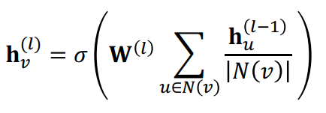
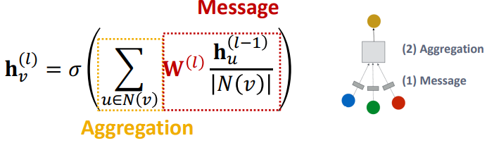
Graph Convolutional Network (GCN)
The GCN can be mathematically represented as the following,
It can be written in the Message + Aggregation format as the following,
Similarly, other forms of GNNs can be constructed by modifying the message passing mechanism and aggregating function e.g., GraphSAGE which uses a two-stage aggregation, Graph Attention Networks which use attention mechanism to give importance to messages during message passing.

Slide 12
Types of prediction tasks.
There are three general types of prediction tasks on graphs:
Node level: predict some property for each node in a graph, e.g., predict whether a particular sensor is anomalous.
Edge level: predict the property or presence of edges in a graph. e.g., perform relational inference between sensors.
Graph level: predict a single property for a whole graph, e.g., assuming that each sample can be represented as a graph, then determining whether a sample is anomalous.

Slide 13
cHALLENGES
29 August 2024
Info class internal Department / Singapura Ravi Varun / Summer Job Presentation

Slide 14
Challenges
To perform anomaly detection on the SKAB dataset using Graph Neural Networks the first main challenge was the absence of graph structured data.
So, the initial approach was to use a fully connected graph i.e., all sensors are connected to one another.
The next approach was to use a graph produced by causal inference.
Then, attention mechanism was used to dynamically learn the adjacency matrix and then use GNNs.

Slide 15
EXPERIMENTS/Approaches
29 August 2024
Info class internal Department / Singapura Ravi Varun / Summer Job Presentation

Slide 16
Experiments/Approaches
For the fully connected graph, the kind of model used was a GCN-LSTM
For the causally inferred graph, the model used was the same as above i.e., GCN-LSTM.
For the graph learnt dynamically using the attention mechanism, additional ”Multi-head attention” heads were used ahead of the GCN-LSTM architecture.
Finally, T-test and the Wilcoxon ranked test were applied to compare the models’ performance metrics against one another and to determine any significant differences.

Slide 17
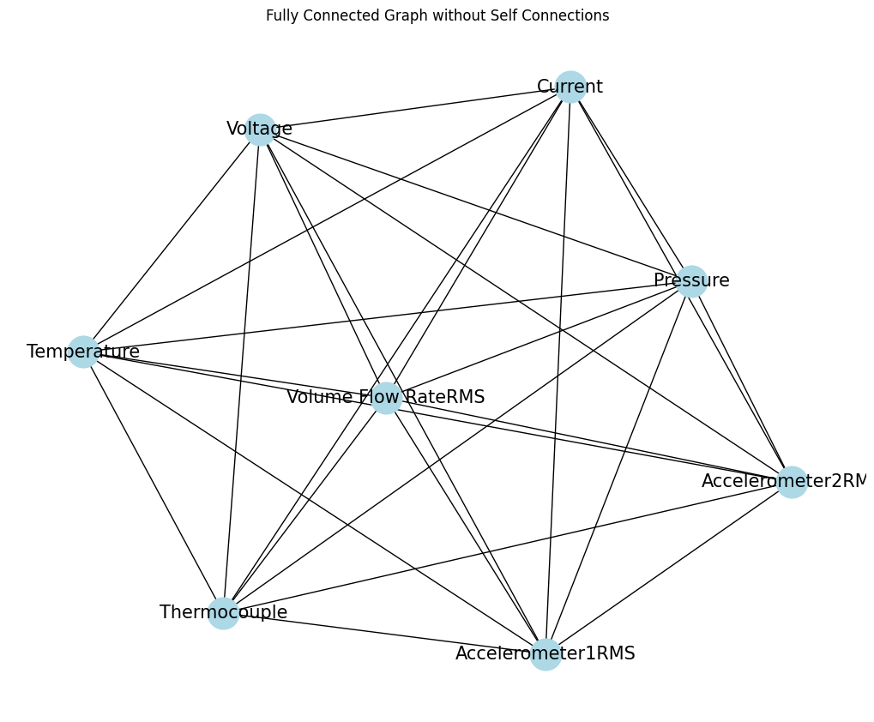
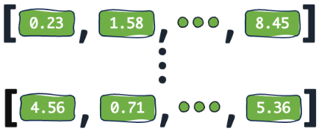
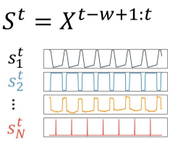
Fully Connected Graph
Intermediate Linear layers to transform forecasted embeddings back to the original feature space
Anomaly Detection
GCN
LSTM
The GCN module learns the Graph level embeddings at time step t
The LSTM module learns to forecast the (t+1) embeddings

Slide 18
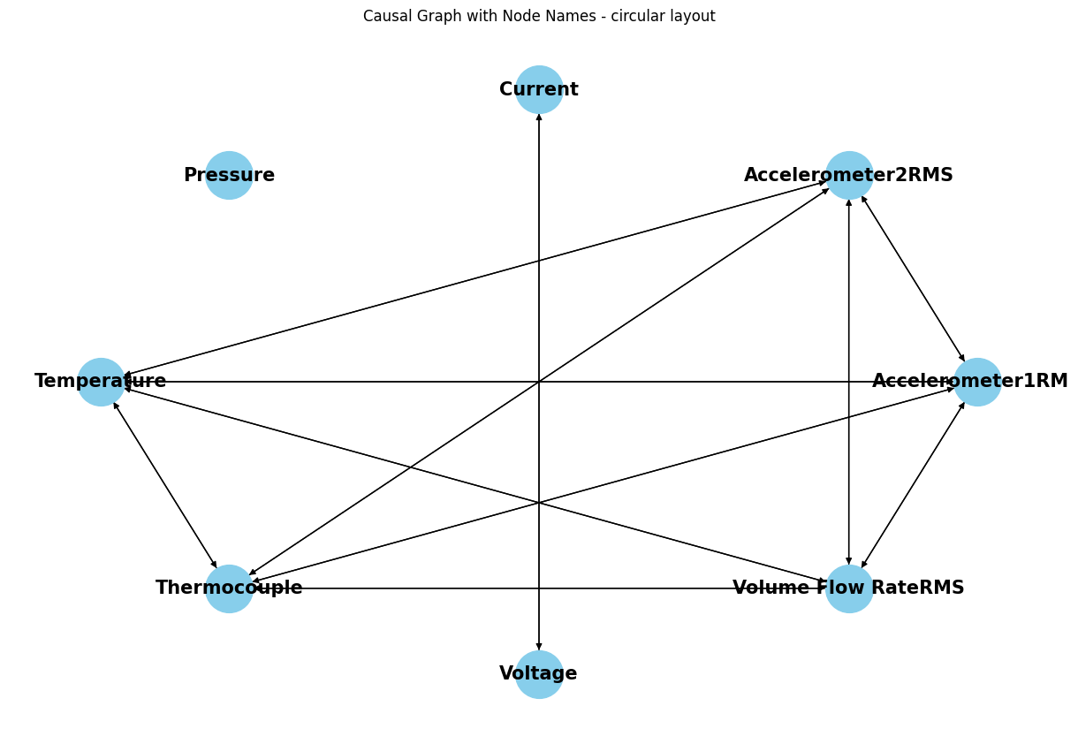
Causally Inferred Graph
Intermediate Linear layers to transform forecasted embeddings back to the original feature space
Anomaly Detection
GCN
LSTM
The GCN module learns the Graph level embeddings at time step t
The LSTM module learns to forecast the (t+1) embeddings

Slide 19
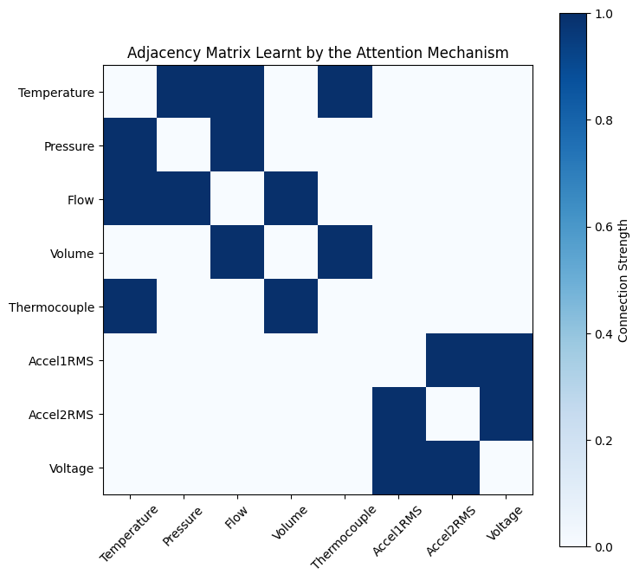
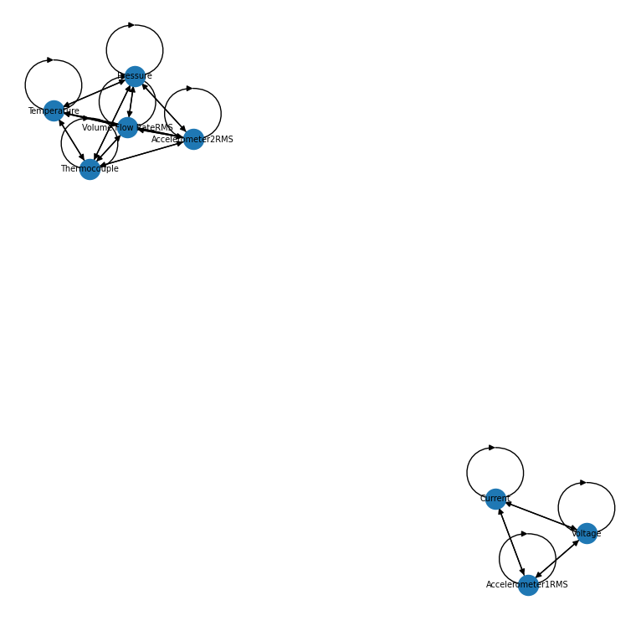

Learning the Graph Dynamically
$$=$$
Intermediate Linear layers to transform forecasted embeddings back to the original feature space
The attention mechanism learns the adjacency matrix for each sample.
Anomaly Detection
GCN
LSTM
The GCN module learns the Graph level embeddings at time step t
The LSTM module learns to forecast the (t+1) embeddings

Slide 20
REsults
29 August 2024
Info class internal Department / Singapura Ravi Varun / Summer Job Presentation

Slide 21
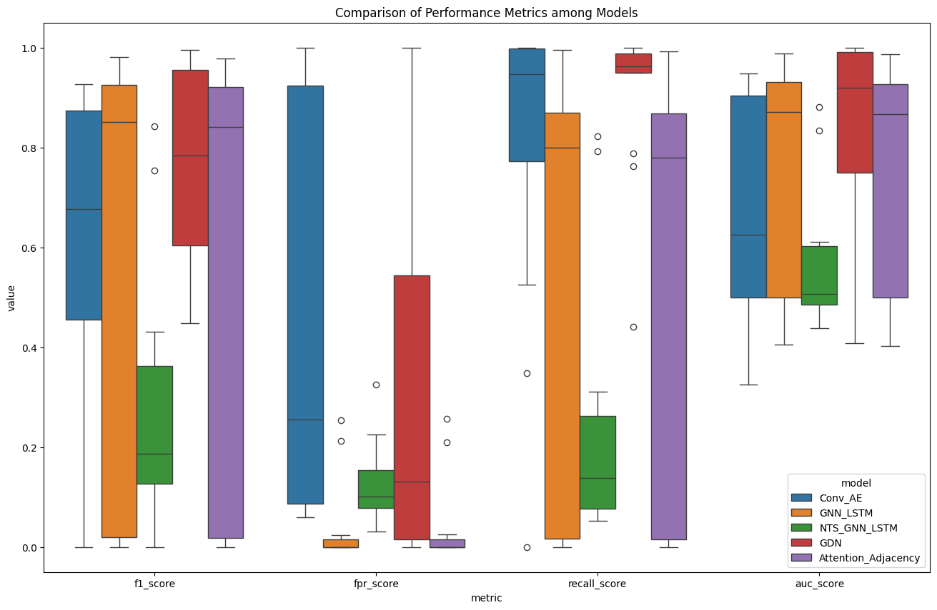
Box-plot Comparison of performance metrics

Slide 22
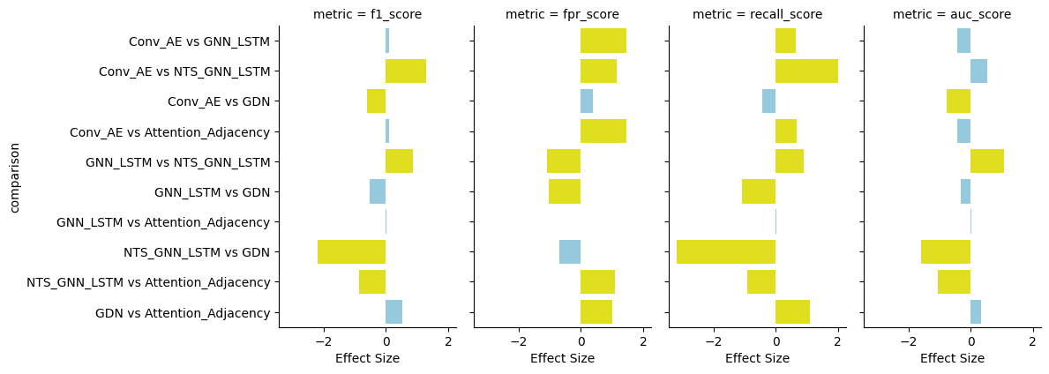
Effect Size Comparison Across Key Metrics: Highlighting Significant Differences

Slide 23
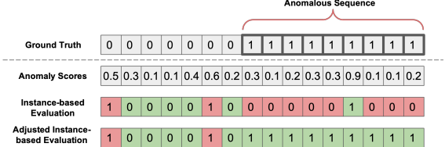
Flaws in SOTA
GDN, a SOTA research paper was evaluating their models by determining anomaly thresholds on the test dataset.
GRELEN, another SOTA research paper has the following flaws:
They also evaluated their models by determining threshold from the test data.
Additionally, they adopt the ”adjusted instance-based evaluation” which considers all instances in an anomalous sequence as true positives even if only a single alarm is raised.
This leads to inflated metrics as they naively boost their true positives.

Slide 24
Conclusion
The fully connected graph and dynamically learning the graph via attention mechanism approaches outperformed the Convolutional Autoencoder model used during thesis.
The causally learnt graph approach yielded a much worse performance than all other approaches, this could be because the causal learning algorithm constructed the graph without taking into account the temporal aspect of the data.
The graph learnt dynamically via the attention mechanism achieved results on par with the fully connected graph approach reflecting its success, although it can be improved.
Determining the anomaly threshold remains a significant bottleneck in the entire process and could be part of the learning objective by employing contrastive or self-supervised learning.
Existing research works like GDN and GRELEN also suffer from determining anomaly threshold and use naive approaches, which leads to inflated performance metrics.

Slide 25
Future Work
Relational Inference i.e., loss of relationships between sensors during anomalous behaviour could be predicted (link prediction)
Node prediction i.e., predicting which sensor is anomalous.
Contrastive learning to incorporate learning the threshold for classifying anomalies.
Self-supervised learning-based anomaly detection.
More causal inference algorithms could be explored to learn better graphs.
Exploring probabilistic classifier heads to better learn the underlying data distribution.

Slide 26
REsults
REsults
THANK YOU

